Slide 1
DIGITAL ELECTRONICS-UNIT 2
BOOLEAN ALGEBRA

Slide 2
Boolean Algebra
Boolean Algebra is used to analyze and simplify the digital (logic) circuits.
It uses only the binary numbers i.e. 0 and 1.
It is also called as Binary Algebra or logical Algebra.
Boolean algebra was invented by George Boole in 1854.

Slide 3
Laws of Boolean Algebra
Following are the three basic laws of Boolean Algebra.
Commutative law
Associative law
Distributive law

Slide 4
Commutative law
The commutative law for addition of two variables is written as
A+B = B+A
In a similar way the commutative law for multiplication of two variables is written as
AB = BA

Slide 5
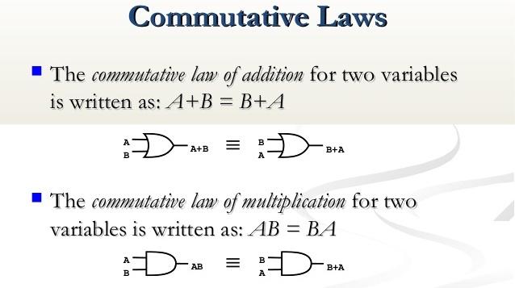

Slide 6
Associated law
The associative law for addition of three variables is written as
A+ (B+C) = (A+B)+C
Similarly for multiplication is
A(BC) = (AB)C

Slide 7
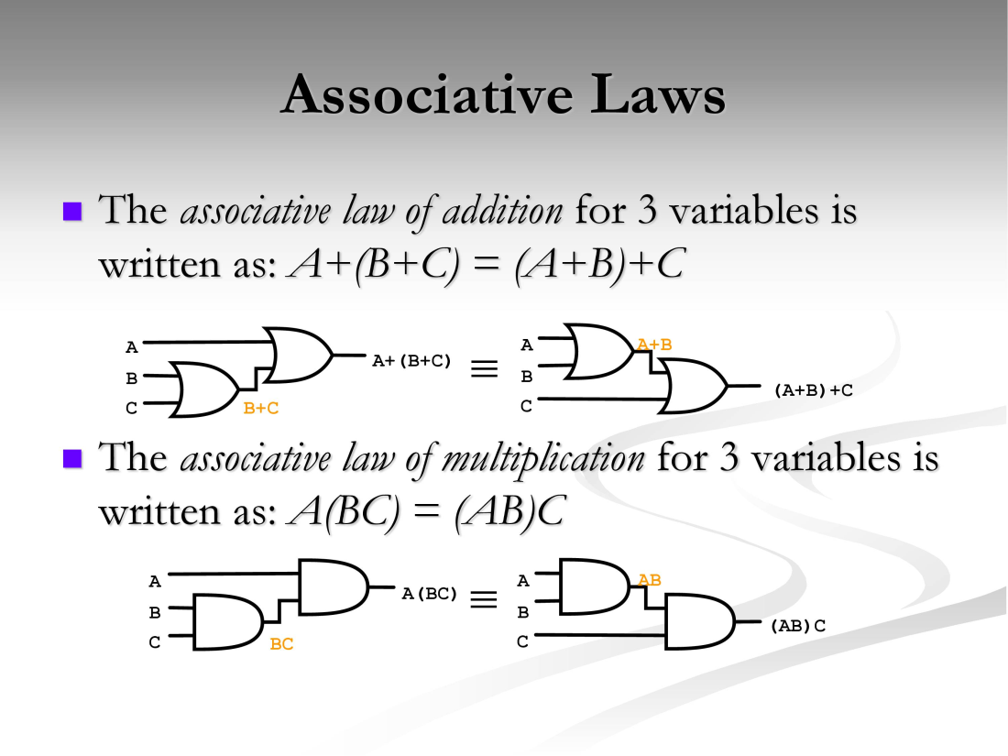

Slide 8
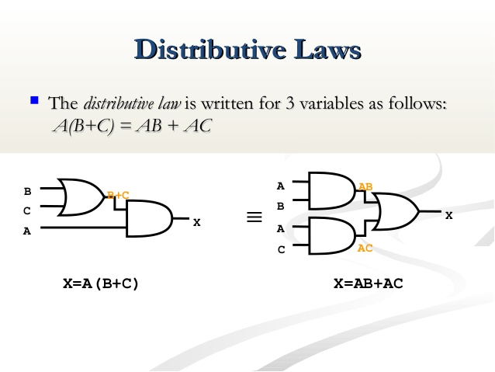
Distributive law
The distributive law for three variables is written as
A(B+C) = AB + BC

Slide 9
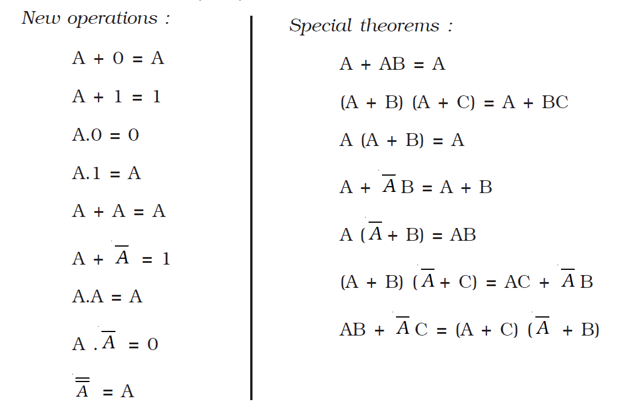
Boolean Algebra

Slide 10
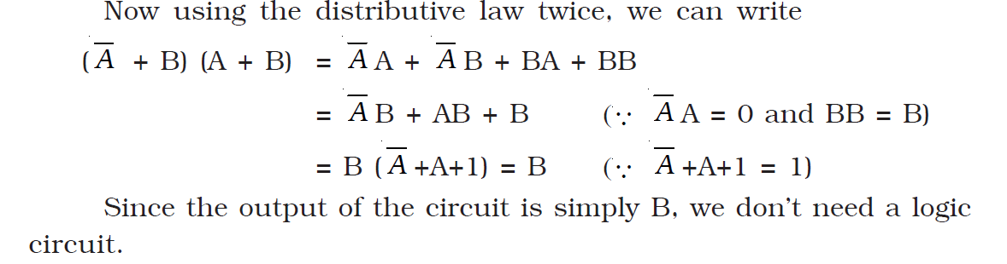
Simplification of Boolean equation

Slide 11
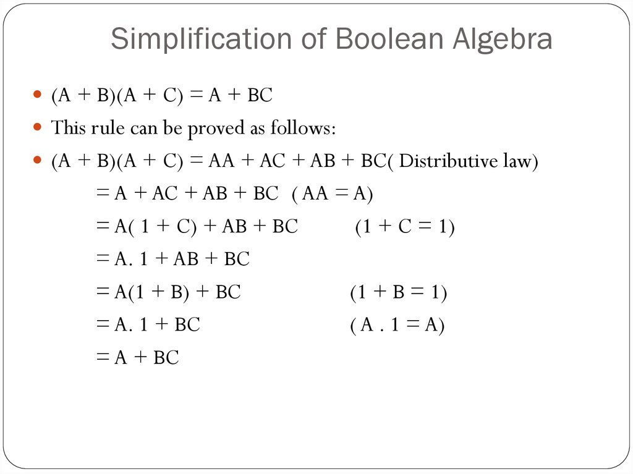

Slide 12
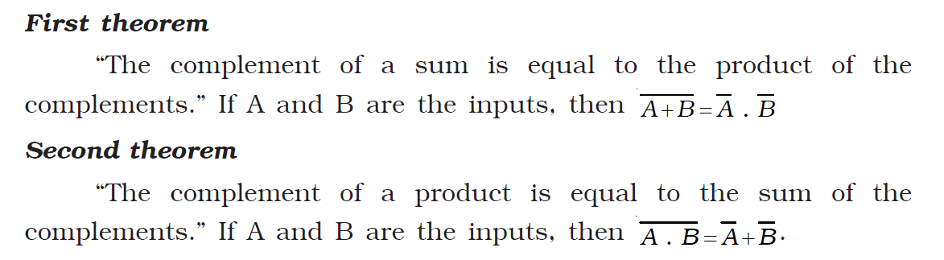
De Morgan’s theorems

Slide 13
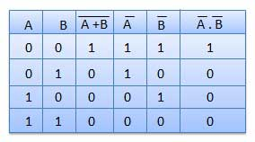
Theorem 1

Slide 14
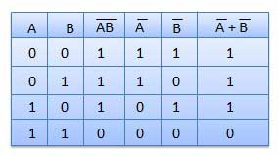

Slide 15
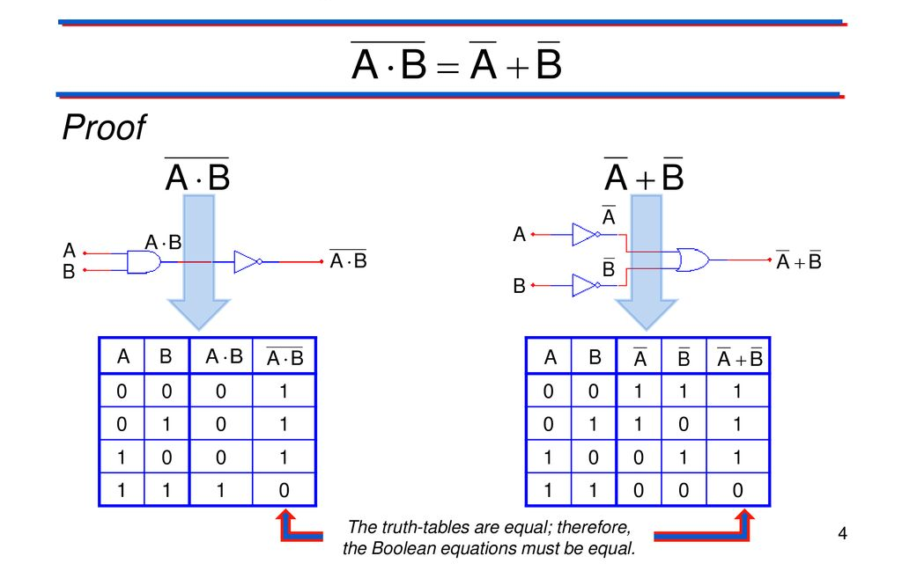
Theorem 2

